Slide 1
Java Programming
Loops

Slide 2
Outline
Loop statements
While statement
Do-while statement
For statement
Examples
Compound interest
Mortgage payment
factorial
Quiz
break & continue statements
Example: Control how your program exits
Nesting Loops
Chinese multiplication table
star triangles

Slide 3

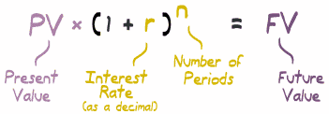
Compound interest
Find the Future value(FV) according to given present value (PV), interest ratio and number of periods.

Slide 4
While-loop statement
INITIALIZATION;
while (LOOP-CONDITION) {
STATEMENTS;
UPDATE;
}

Slide 5
Do-while loop statement
INITIALIZATION;
do {
STATEMENTS;
UPDATE;
} while(LOOP-CONDITION);
The difference between do-while and while is that do-while evaluates its expression at the bottom of the loop instead of the top. Therefore, the statements within the do block are always executed at least once.

Slide 6
Explanations
LOOP-CONDITION: The loop condition is used to control the execution of the loop body. It is an boolean expression which includes one or more loop variables. If the expression is true, the loop repeat.
INITIALIZATION: Before the loop statement executes, we should initialize the loop variables.
STATEMENTS: the statements will be executed repeatedly.

Slide 7
Explanations
UPDATE: The body of the loop should change the value of loop variables so that, eventually, the condition becomes false and the loop terminates. Otherwise the loop will repeat forever, which is called an infinite loop.
We must avoid infinite loop!
This type of loop is so common that there is another statement, the for loop, that expresses it more concisely.

Slide 8
For-loop statement
for (INITIALIZATION; LOOP-CONDITION; UPDATE){
STATEMENTS;
}
The while loop and for loop can be replaced with each other!
There is one difference between for loops and while loops: if you declare a variable in the initializer, it only exists inside the for loop.

Slide 9
Compound interest
Find the Future value(FV) according to given present value (PV), interest ratio and number of periods.

Slide 10
MoneyUtils.java
public class MoneyUtils {
public static void main(String[] args) {
double fv, pv=1000.0, r=0.1;
int N=10;
fv=pv;
for(int i=0;i<N;i++) fv=fv*(1+r);
System.out.println(fv);
}
}

Slide 11
MoneyUtils.java (while version)
public class MoneyUtils {
public static void main(String[] args) {
double fv, pv=1000.0, r=0.1;
int N=10,i=0;
fv=pv;
while(i<N){
fv=fv*(1+r);
i++;
}
System.out.println(fv);
}
}

Slide 12
MoneyUtils.java (do-while version)
public class MoneyUtils {
public static void main(String[] args) {
double fv, pv=1000.0, r=0.1;
int N=10,i=0;
fv=pv;
do{
fv=fv*(1+r);
i++;
}while(i<N);
System.out.println(fv);
}
}

Slide 13

MoneyUtils.java (method version)
public class MoneyUtils {
public static void main(String[] args) {
double fv = FV(1000.0,0.1,10);
System.out.print(“The future value is ”+fv);
}
public static double FV(double pv, double r, int N) {
double fv=pv;
for(int i=0;i<N;i++) fv=fv*(1+r);
return fv;
}
}

Slide 14
Round to nearest hundredth
Two system classes can be used to round the result to nearest hundredth
BigDecimal
DecimalFormat
BigDecimal
The BigDecimal class provides operations for arithmetic, scale manipulation, rounding, comparison, hashing, and format conversion.
Notes:
http://docs.oracle.com/javase/7/docs/api/java/math/BigDecimal.html

Slide 15
Round to nearest hundredth
public static double round(double mt, int scale) {
BigDecimal bmt = new BigDecimal(mt);
double nmt =
bmt.setScale(scale,BigDecimal.ROUND_HALF_UP).doubleValue();
return nmt;
}
Converts this BigDecimal to a double
Returns a BigDecimal whose scale is the specified value

Slide 16
Round to nearest hundredth
DecimalFormat
The DecimalFormat class formats decimal numbers. It supports different kinds of numbers, including integers (123), fixed-point numbers (123.4), scientific notation (1.23E4), percentages (12%), and currency amounts ($123).
DecimalFormat df = new DecimalFormat("0.00");
System.out.println(df.format(fv));
Format pattern
Returns a String value

Slide 17
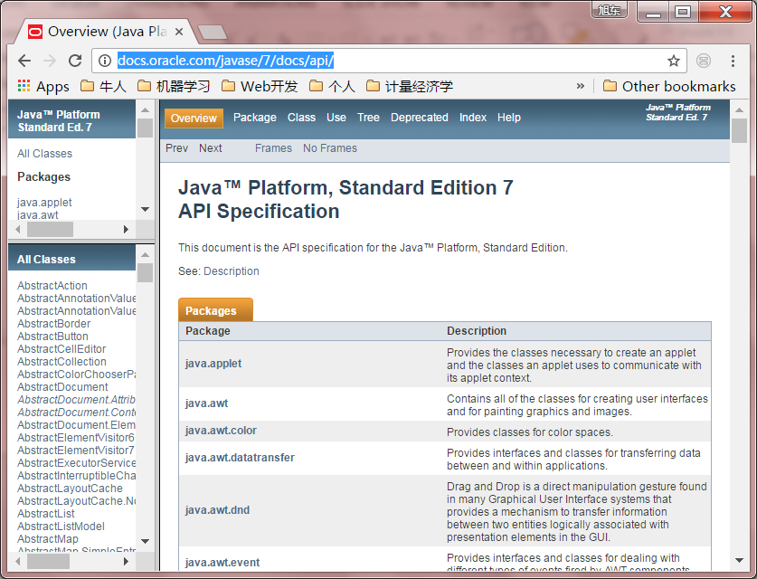
Java API specification
http://docs.oracle.com/javase/7/docs/api/

Slide 18
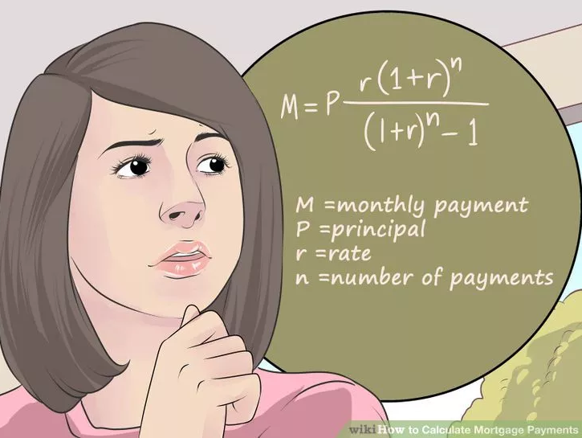
Mortgage payment

Slide 19
Mortgage payment
public static double mortgage(double pv, double r, int N) {
double mt=1.0;
for(int i=0;i<N;i++) mt=mt*(1+r);
mt=pv*r*mt/(mt-1);
return round(mt,2);
}

Slide 20
Calculate the factorial of N
public static long Fact(int N){
if(N>0 && N<20) return -1;
int counter = N;
long factorial = 1;
while (counter > 1) {
factorial *=counter--; /* Multiply, then decrement. */
}
return factorial;
}

Slide 21
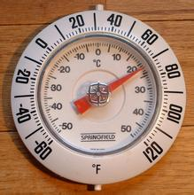
Quiz: Celsius and Fahrenheit
List the Frequently used Temperature both in Celsius (from -50 to 50) and Fahrenheit scales.
Round to the nearest tenth (e.g. 838.274 rounded to the nearest tenth is 838.3)
C=(5/9)*(F-32)
F=(9/5)*C+32

Slide 22
Break, continue & return statement
break terminates a for or while loop
continue skips the current iteration of a loop and proceeds directly to the next iteration
return exits the method

Slide 23
Print the odd numbers
Public static void printOddNumbers(int N){
for (int i = 1; i <= N; i++) {
if (i % 2 == 0)
continue; // skip next statement if i is even
System.out.print(i + " ");
}
System.out.println();
}

Slide 24
Variable scope
Variable scope refers to the accessibility of a variable. The scope of the variable is the block in which it is defined.
You cannot refer to a variable before its declaration.
You can declare variables in several different places:
In a method's body as local variables
As parameters of a method or constructor.
In a method's body or a constructor's body.
Within a statement block, such as inside a while or for block.
In a class body as class fields. Variables declared here are referred to as class-level variables (we will talk about it in the future).
Notice:
If a method declares a local variable that has the same name as a class-level variable, the former will 'shadow' the latter.

Slide 25
Variable scope
Public static void printOddNumbers(int N){
int count;
for (int i = 1; i <= N; i++) {
if (i % 2 == 0)
continue; // skip next statement if i is even
System.out.print(i + " ");
count++;
}
System.out.println(“i=”+i);//error! i is not valid here!
System.out.printf(“there are %d odd numbers%n”,count);
}

Slide 26
check prime number
public static Boolean isPrime(int N) {
for(int i=2;i<=N-1; i++)
if( N%i==0 ) return false;
return true;
}

Slide 27
check prime number
public static Boolean isPrime(int N) {
for(int i=2;i<=sqrt(N); i++)
if( N%i==0 ) break;
if( i>sqrt(N) )return true;
else return false;
}

Slide 28
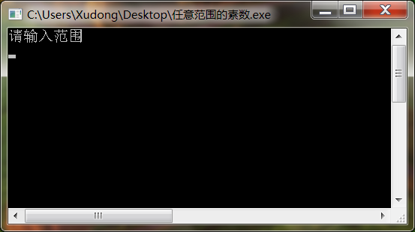
Control How your program exits
Run you program, Operating System will open a widow (black background) waiting for your input
Input something ….
Calculating and outputting …
Disappearing …

Slide 29
Control How your program exits
public static void menu() {
int choice=0;
Scanner sc = new Scanner(System.in);
while(true){
System.out.println("functions:");
System.out.println("1: calculate future values");
System.out.println("2: calculate mortgage payment");
System.out.println("0: exit");
System.out.println("please input your choice:");
choice = sc.nextInt();
switch (choice){
case 0:
return;
case 1:
…
break;
…
}
}

Slide 30
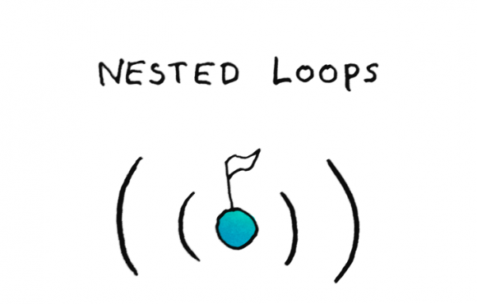
Nested loops
A nested loop is a loop within a loop, an inner loop within the body of an outer one.
Nested for
Nested while
Nested do while
How this works is that the first pass of the outer loop triggers the inner loop, which executes to completion. Then the second pass of the outer loop triggers the inner loop again. This repeats until the outer loop finishes.

Slide 31
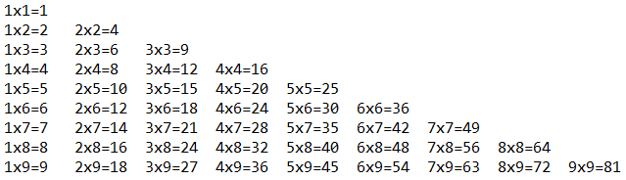
Chinese multiplication table
Also called nine nine table. It was known in China as early as the Spring and Autumn period, and the pupils in Chinese elementary school today still must memorize it.
Let’s print it using java.

Slide 32
Chinese multiplication table
public static void nineNineTable(){
for(int i=1;i<=9;i++){
for(int j=1;j<=i;j++)
System.out.printf(""+j+"x"+i+"="+i*j+"\t");
System.out.println();
}
}

Slide 33

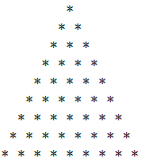


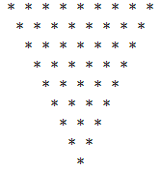

Star Triangles
Print different triangles using ‘*’
lower isosceles triangle
Lower right triangle
Lower left triangle
Upper right triangle
Upper left triangle
upper isosceles triangle

Slide 34
Upper left triangle
public static void upperLeftTriangle(int N){
for(int i=1;i<=N;i++){
for(int j=N;j>=i;j--)
System.out.print("*");
System.out.println();
}
}

Slide 35
Upper right triangle
public static void upperRightTriangle(int N){
for(int i=1;i<=N;i++){
for(int j=1;j<i;j++)
System.out.print(" ");
for(int j=N;j>=i;j--)
System.out.print("*");
System.out.println();
}
}

Slide 36
Refactor: Upper right or left triangle
public static void upperTriangle(int N, boolean right){
for(int i=1;i<=N;i++){
if (right ==true)
for(int j=1;j<i;j++)
System.out.print(" ");
for(int j=N;j>=i;j--)
System.out.print("*");
System.out.println();
}
}

Slide 37


